Slide 1
Zwischen Car Sharing
Brandon Davis, Zachary Greening,
Gage Kettering, Tyler Marlow, Chuck Taylor

Slide 2
Team Zwischen
Brandon Davis – Notifications window | Driver schedule window
Zachary Greening – Main Window
Gage Kettering – Friends list window | Messages window
Tyler Marlow – Login window | Create account window | View / edit window
Chuck Taylor – View Drivers | View History

Slide 3
Overview
Seventy-eight percent of Americans do not carpool, and nearly all of automobiles have more than one seat. It simply doesn’t make sense for everyone to be driving and taking up the same parking spaces. Our team’s plan is to combat this problem with a program that will link users who have similar destinations and are near each other to communicate and organize a carpool. The features of this product will include a user friendly interface with easy ways of communicating status.

Slide 4
Functionality
Home Screen - ability to access all other screens as well as make the ride request
Message Screen - users can send and receive messages from users on their friends list
Friends List - this window will display a list of users that have been added to your friends list and will display if they are a driver or a rider
Login - user enters username and password to login or can access create account screen to create account
Create Account - user enters a username, password, email, and phone number

Slide 5
Functionality Cont’d
Edit Account - can add first and last name, and change login credentials
Notifications - user can receive and view alerts that in include: confirmations, messages, ride requests, and user-to-user interactions
Driver Schedule - users can set a weekly drive schedule
View Drivers - users can view available drivers after requesting a ride
View Ride History -User can view past rides and send messages or friend requests to users they have ridden with recently

Slide 6
Schedule
Design + Planning Oct. 8, 2018
Project Management Plan + SRS Oct. 12, 2018
Prototype 1 + Presentation 1 Oct. 21, 2018
User’s Manual Nov. 10, 2018
Source, Executable, Build instructions Nov. 13, 2018
Prototype 2 + Presentation 2 Nov. 25, 2018

Slide 7
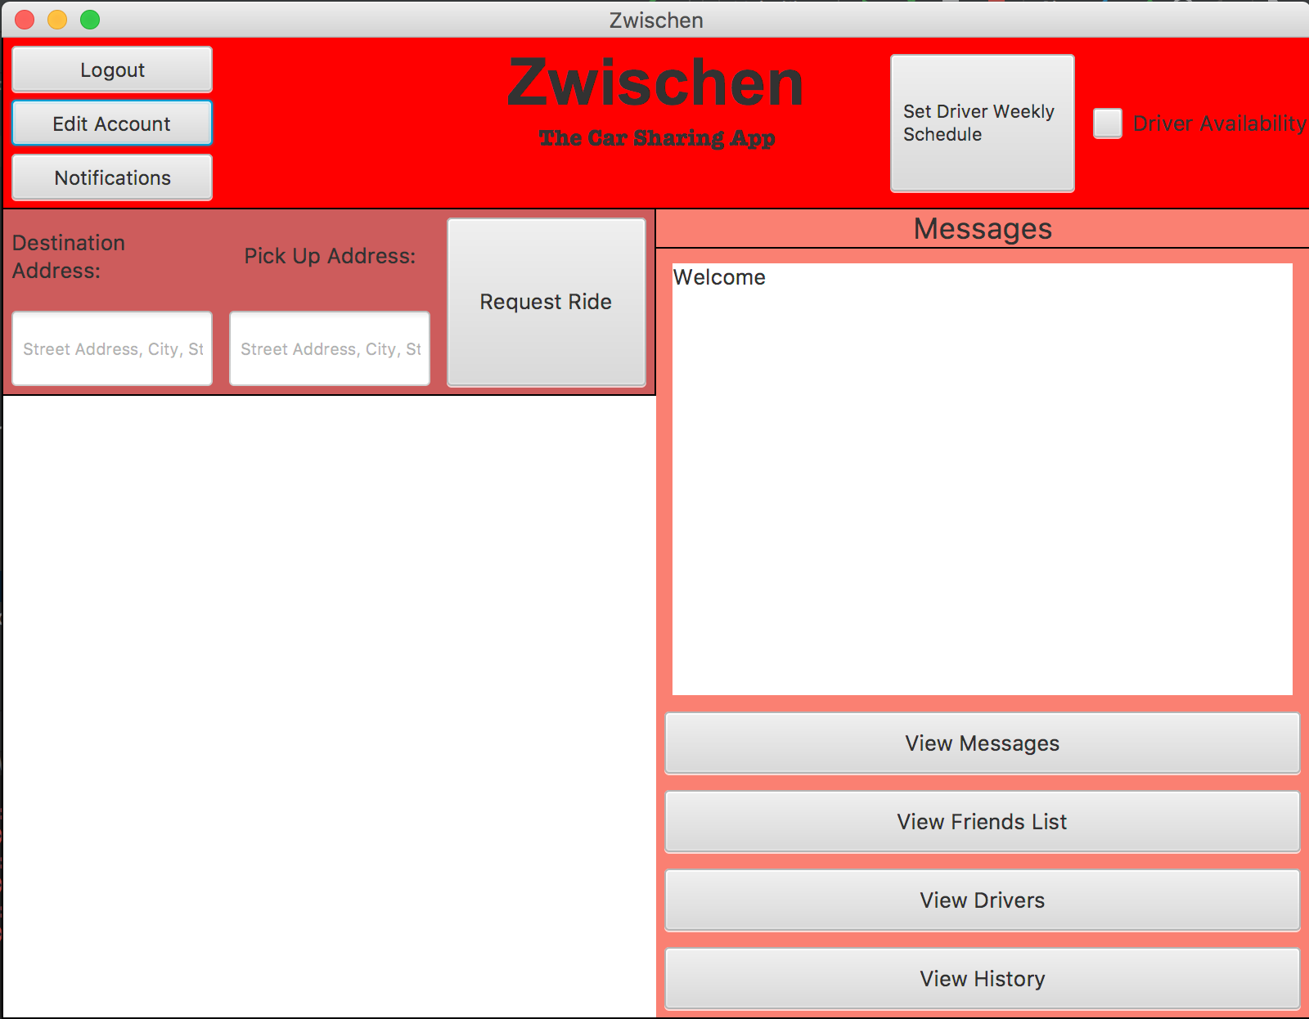
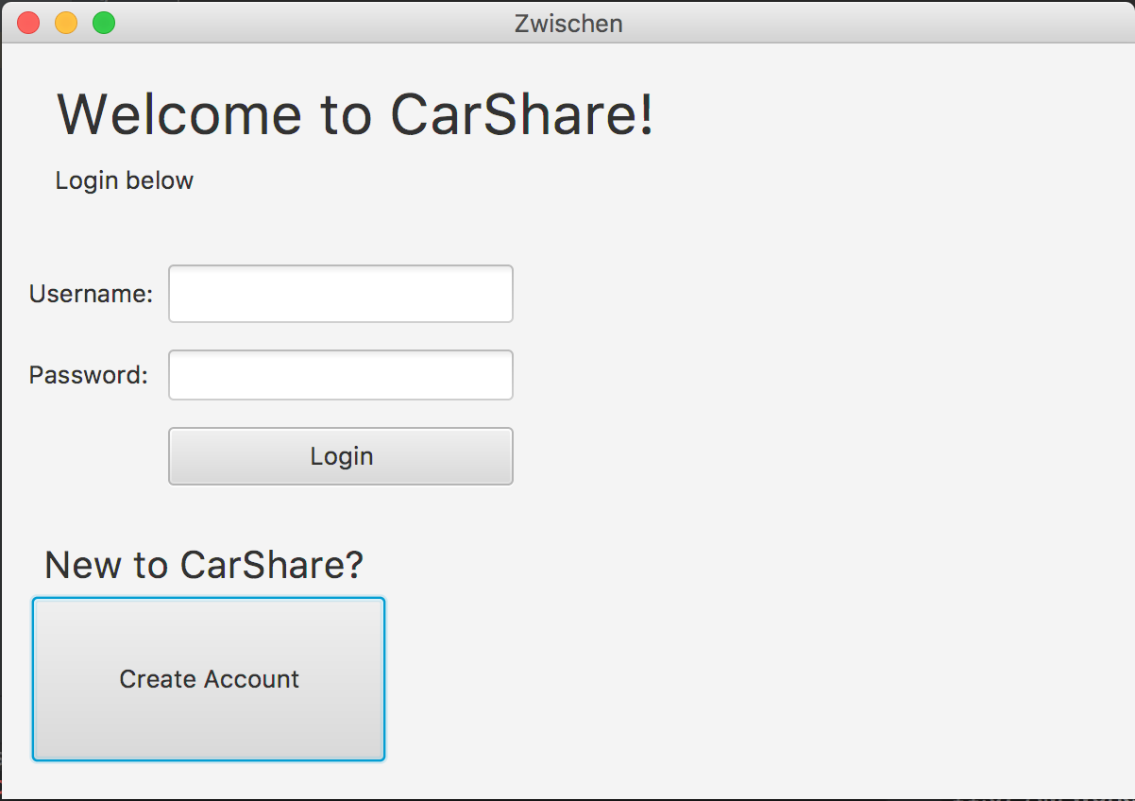
Prototype Images

Slide 8
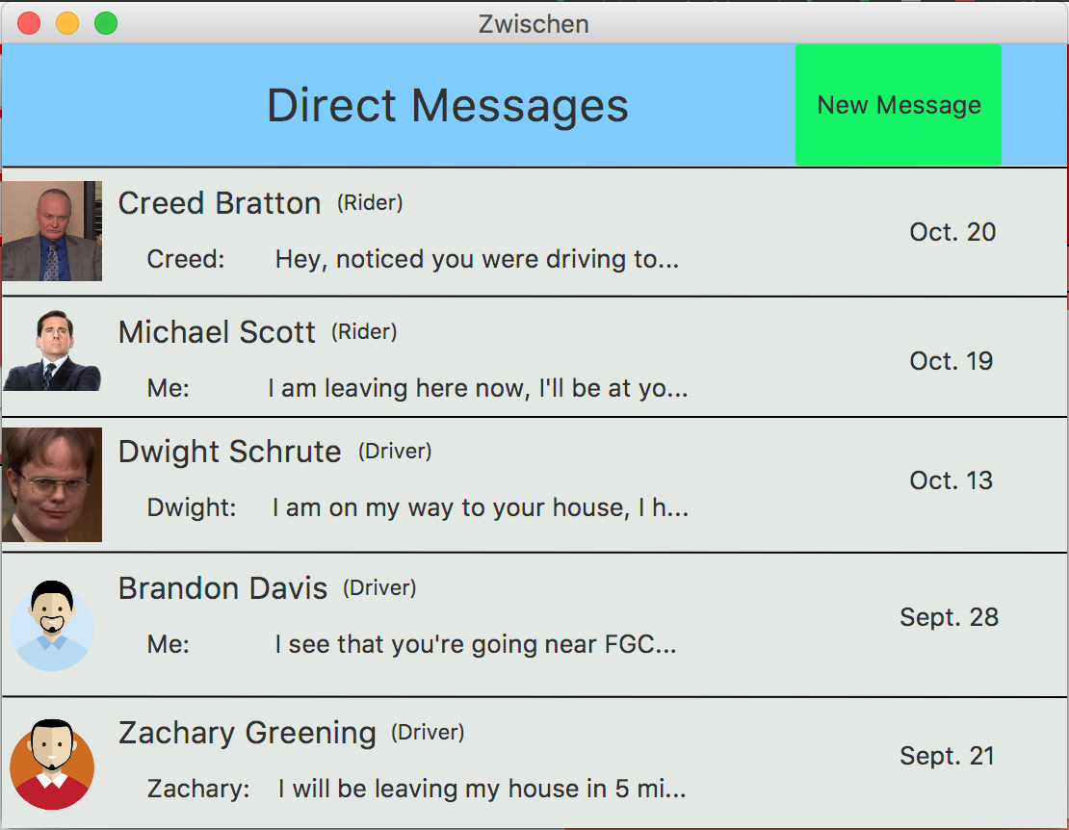
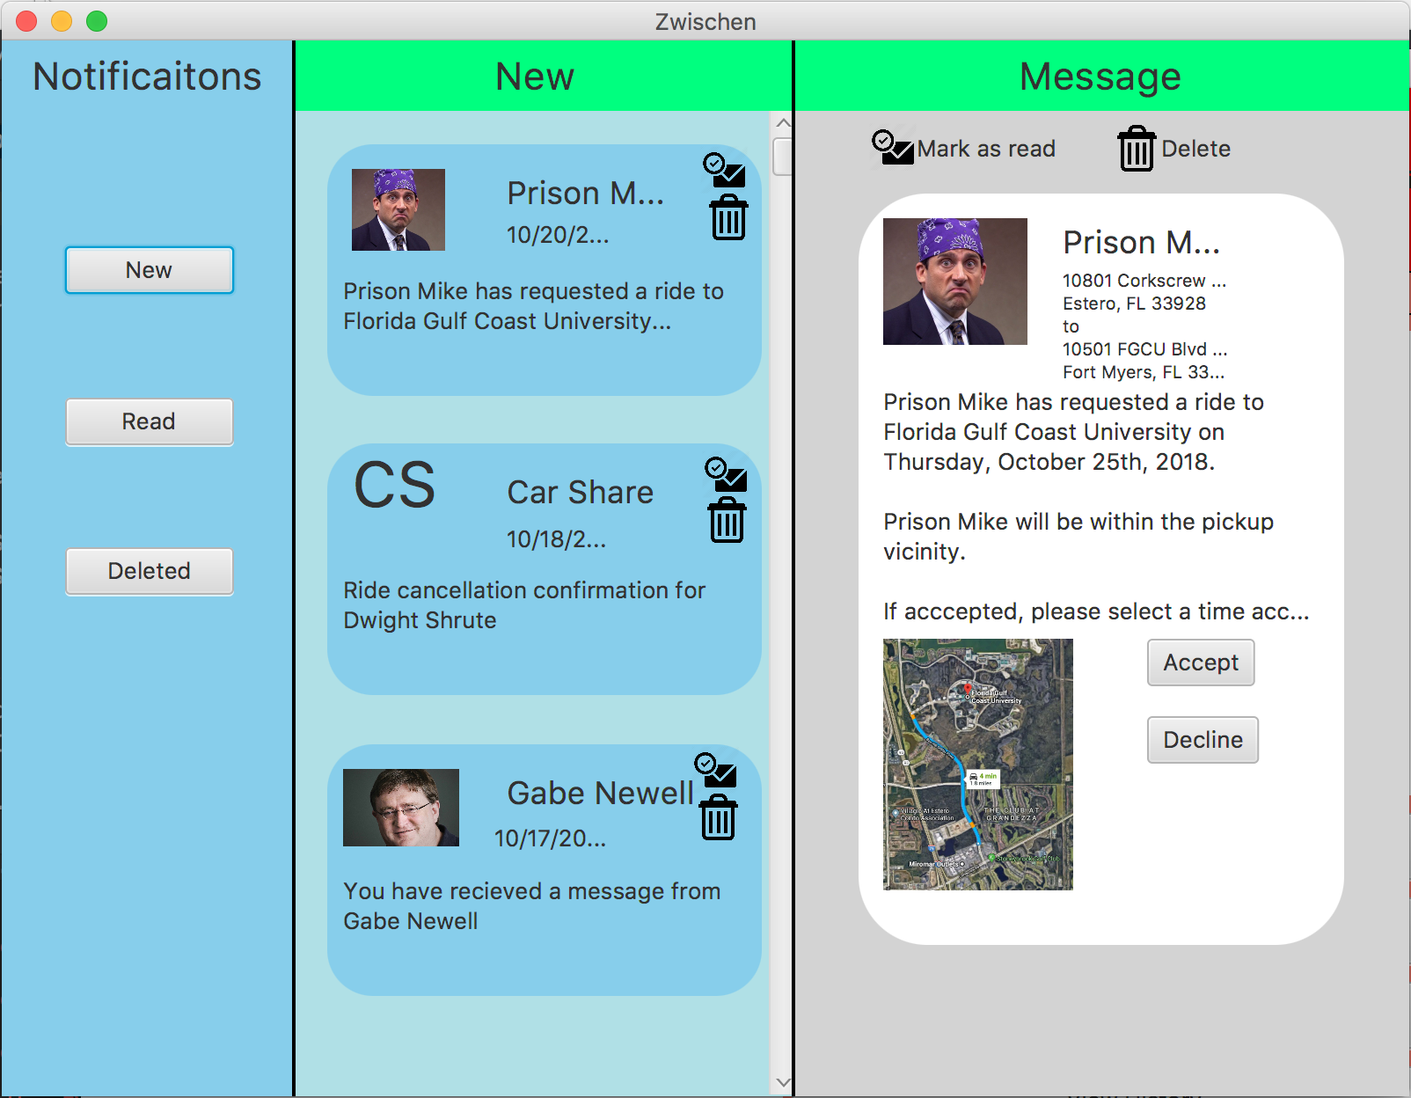
Prototype Images Cont’d

Slide 9
Video
https://youtu.be/tj8TxeMg8jg

Slide 10
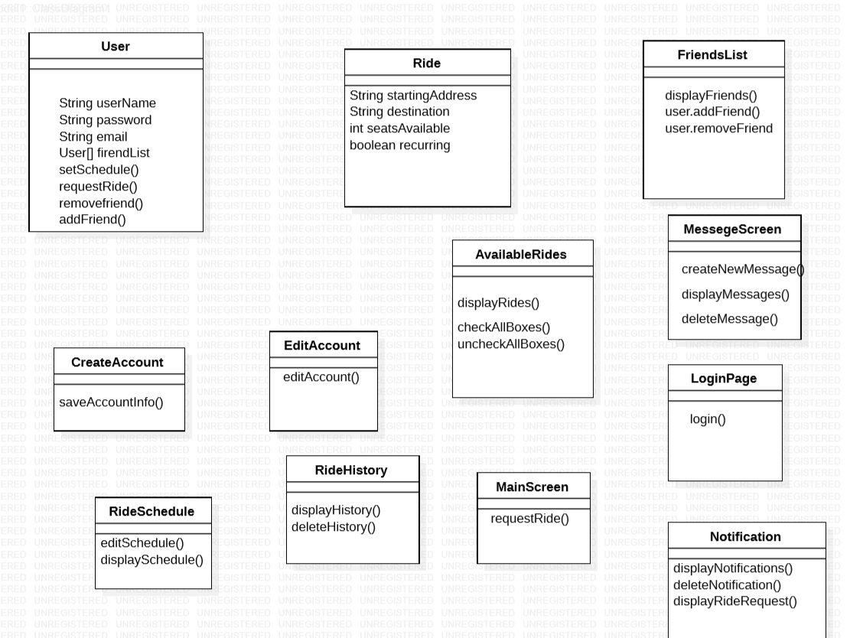
Class Diagram

Slide 11
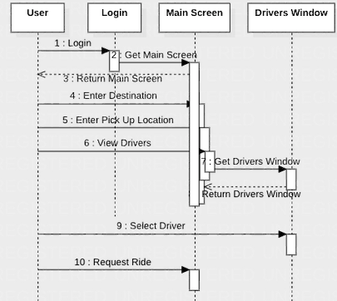
Sequence Diagram
Scenario: User wants to request a ride with a specific driver.

Slide 12
In the coming future...
Gage - Add functionality to the message screen, allowing users to send and receive messages from friends. Add functionality to friends list screen, allowing users to send friend requests as well as receive friend requests.
Brandon - The notification window shall notify alerts to the user with a sound. In addition, notifications will also inform about location to destination travel time changes. The driver schedule window shall allow users to filter results. Filter options will include: location, destination, date, time, and available seats.

Slide 13
In the coming future...
Tyler - create Account, Login Account, Edit Account. For the login screen I plan to start focusing on storing user info. In the edit account page I plan to improve functionalities. For create account I plan to improve formatting and professionalism
Zach - Main Screen and other organization of project -Work will be in organizing and passing information from the main screen to other windows. As well as, looking into incorporating a map for getting addresses
Chuck - Ride History and View Drivers screens will receive aesthetic updates, and logic will be implemented to determine what shall be shown and how many things will be shown.

Slide 14
Thank you!
Any Questions?

